Slide 1
Coursera Capstone IBM Applied Data Science Capstone “The Battle of Neighbourhoods” COURSERA CAPSTONE – Finding a location to open an Indian restaurant in Manhattan New York
By :
Ankur Mehta

Slide 2
Introduction
The United States of America is the country with one of the largest immigrant population in the world. After the IT boom , this immigration in recent times has been driven by IT workers from Asia coming into the states. A large number of them belong to India which due to its high population and educational system is able to provide one of the cheapest most talented manpower for IT firms. Indians flock by the 1000's to America chasing the American Dream. This has led to a growth of new markets being created that caters to the immigrated folk. One of the most lucrative ones of them being the Indian restaurant business. Indian cooking is known across the world for its diverse flavours and spices . Both Indians and American Nationals alike have taken a great fondness to the Indian Cuisine. This has led to a spurt in the Indian restaurant business. These businesses have specifically targeted places with large Indian population earlier but due to market saturation have started moving away to other parts.
In this project we will try to find an optimal location for an India restaurant. Specifically, this report will be targeted to stakeholders interested in opening an Indian restaurant in Manhattan , New York, USA
Since there are lots of restaurants in New York we will try to detect locations that are not already crowded with restaurants. We are also particularly interested in areas with no Indian restaurants in vicinity.
We will use our data science powers to generate a few most promising neighbourhoods based on these criteria. Advantages of each area will then be clearly expressed so that best possible final location can be chosen by stakeholders.

Slide 3
Problem Statement
The objective of this capstone project will be to find a suitable location to open an Indian Restaurant in Manhattan New York that would have the most chance of being successful by leveraging Data Science and Machine Learning (k - means). The main Business question that will be answered in the Capstone Project will be : “Which neighbourhoods in Manhattan New York are best suitable for an Indian Restaurant

Slide 4
Stakeholders/Target Audience
The Capstone Project will be particularly useful for people looking to open a restaurant in a given area. The project can also be modified to go beyond just the restaurant scope as it can be used to scope out other businesses in the area be it gyms , schools etc . The project can be used in an advisory capability by property consultants, realtors etc who can use the project to give their customer an overview of the area and allow them to make a better informed decision. With basic knowledge, customers themselves can use the this project to better understand the option available with them to make informed business decisions thus improving their chances of being successful.

Slide 5
Data
Data used in this project is the New York dataset and was sourced from: https://cf-courses-data.s3.us.cloud-object-storage.appdomain.cloud/IBMDeveloperSkillsNetwork-DS0701EN-SkillsNetwork/labs/newyork_data.json
The coordinates of places if and when required can be sought by using geopy. Geopy is a Python client for several popular geocoding web services. Geopy makes it easy for Python developers to locate the coordinates of addresses, cities, countries, and landmarks across the globe using third-party geocoders and other data sources
Finally Foursquare API will be used for identifying and analysing areas of interests which basically involves using the API to gather the following details –
Number of venues in a particular area based on the radius provided by the user based on neighbourhood details.
Name of the venue
Category of venues (Restaurants, gyms etc )
Location of the Venue (Latitude , Longitude )

Slide 6
Methodology
Data Collection
Exploring the neighbourhoods using Foursqaure API
Clustering the Data using K - means Algorithm
Visualization of the clusters using Folium Library
Analysing the results to find the best location for the restaurant
Methodology explained in detail in the report

Slide 7
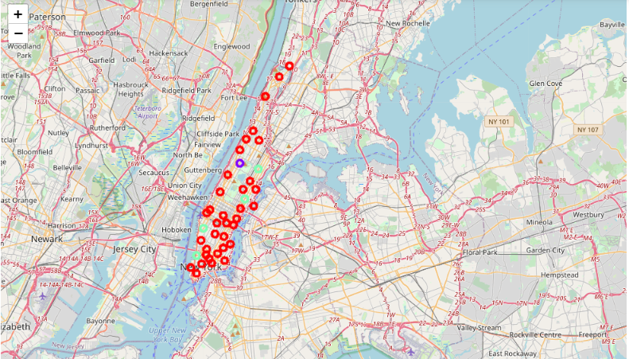
Results & Conclusion
Map of Manhattan after running k-means , dividing Manhattan neighbourhoods into 3 clusters

Slide 8
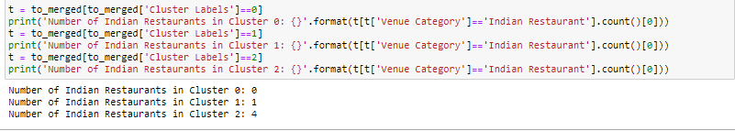
We now take at the results of the clusters which were the output of the k – Means algorithm
We can see from the results above that cluster 0 with no restaurants is best suited for opening a new restaurant as it offers little competition in the matter of other competing Indian Restaurants

Slide 9
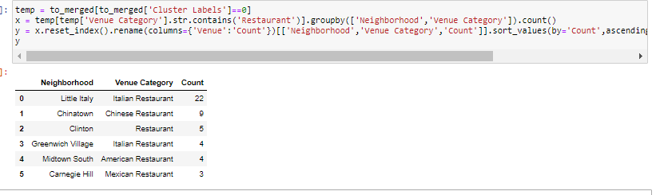
We now further explore the neighbourhoods in detail in the Cluster 0
From the above result it can be seen that there are 5 neighbourhoods in Cluster 0 .
It is visible that the Neighbourhood of Little Italy and Chinatown are saturated with Italian and Chinese Restaurants. It is understood the these neighbourhoods will be tough to open an Indian Restaurant as it might not find enough footfall for our new restaurant.
We should focus our concentration on concentrating on other three neighbourhoods , which are Clinton ,Greenwich Village , Midtown South and Carnegie Hill.
.

Slide 10
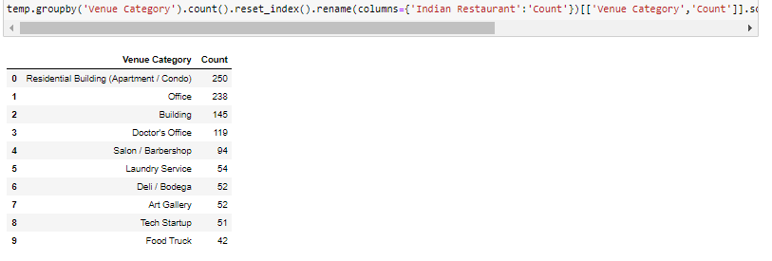
We further take a look at the most popular venues in the cluster

Slide 11
We see that the cluster is a working cluster occupied mostly by Offices and shops . We also notice that as far as the eating scene is concerned ,it is dominated by Deli’s and Food Trucks . Considering the offices and shops giving rise to fast moving footfall an Indian Food Tuck can also be considered an option instead of a Restaurant

Slide 12
Thank You !!!

